Slide 1
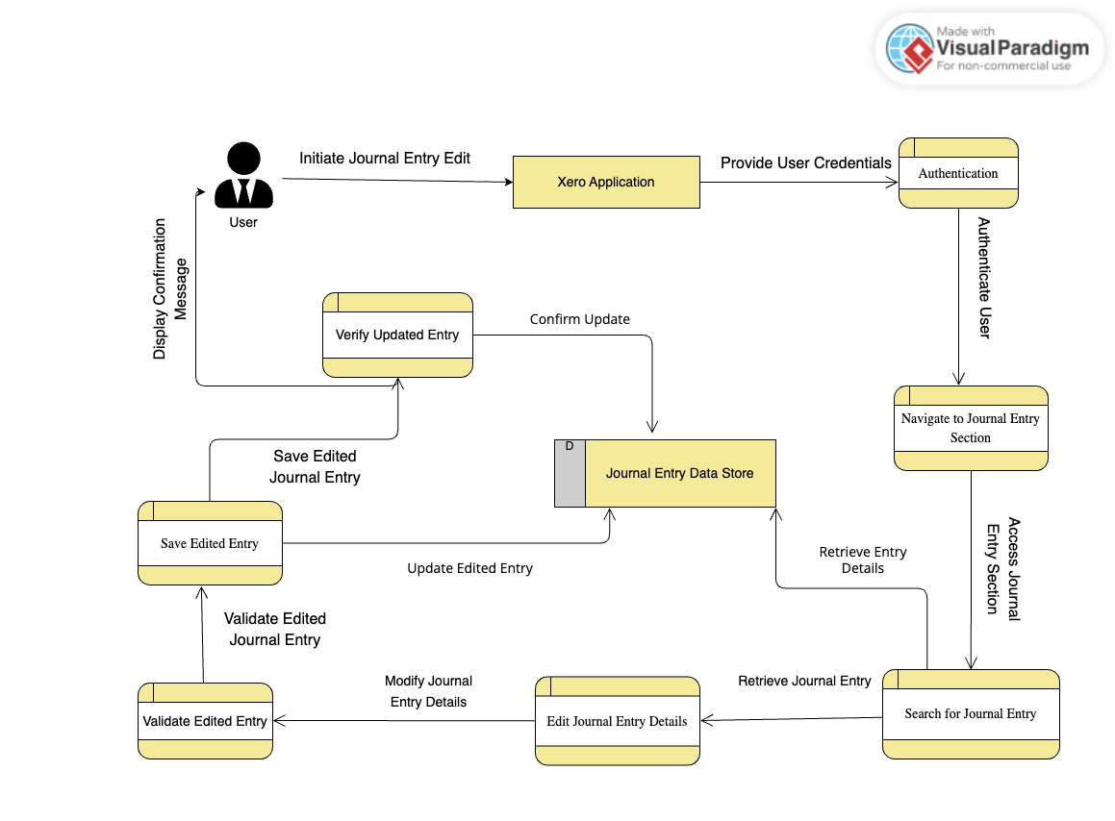
4.14 Edit a Journal

